Slide 1
Convolutional Neural Networks
Lecture 08

Slide 2
Types of Neural Networks
Multi-layer Perceptrons (MLPs)
Base neural network
Used for simple tasks
Convolutional Neural Networks (CNNs)
Uses filters and pooling to find characteristics in data
Mostly used for image tasks
Recurrent Neural Networks (RNNs)
Uses the previous result of data in figuring out new output
Used for temporal data
Auto encoders
A new way to compress data without losing quality
Types of Neural Networks (and what each does!) Explained| Vansh Sethi| Toward Data Science

Slide 3
Definition
What is a CNN
Convolutional networks: neural networks that use convolution in place of general matrix multiplication
Convolution?
s(t) = ʃ x(a)w(t − a)da = ∑x(a)w(t − a) = (x ∗ w)(t)
Weights (kernel) w, observation x
Zi,j,k = ∑ V l,j+m−1,k+n−1 K i,l,m,n
Kernel K, observation V

Slide 4
Common CNN Uses
Image processing
Classification
Image segmentation
Signal processing
Natural Language Processing (NLP)
Speech recognition
Generative models in signle cell genomics for disease ID
Astrophysics – interpret radio telescope data
An Introduction to Convolutional Neural Networks| Christopher Thomas BSc Hons. MIAP May 27, 2019| Toward Data Science

Slide 5
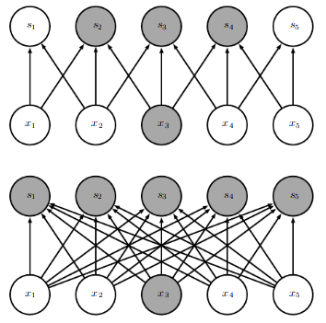
Motivation (1/4)
Sparse interaction
Kernel smaller than input
Store fewer parameters (O(k x n) vs O(m x n))

Slide 6
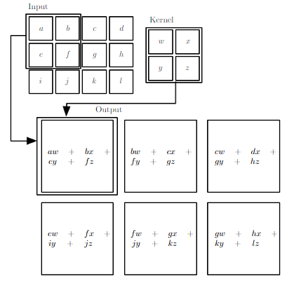
Motivation (2/4)
Parameter sharing
Tied weights

Slide 7
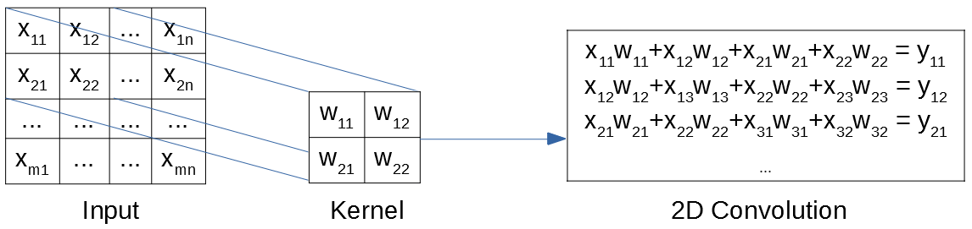
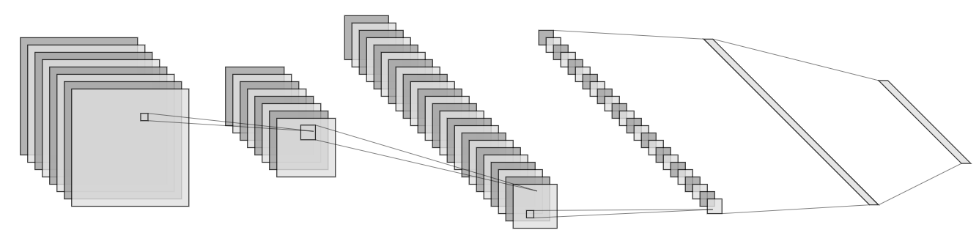
Motivation (3/4)

Slide 8
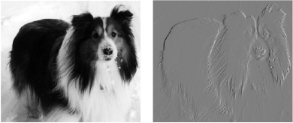
Motivation (4/4)
Equivariant representation
If the input changes, the output changes in the same way
Map of features
Ex: edge detection

Slide 9
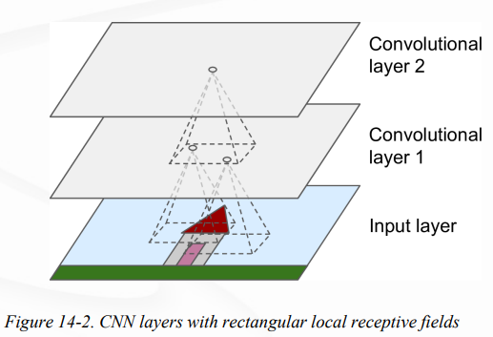
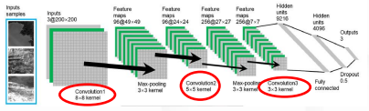
Convolutional Layer
Key building blocks in CNNs
Filter -> Image -> map of activations … repeat
Result: feature map
Result: strength of a detected feature in an input
https://machinelearningmastery.com/convolutional-layers-for-deep-learning-neural-networks/

Slide 10
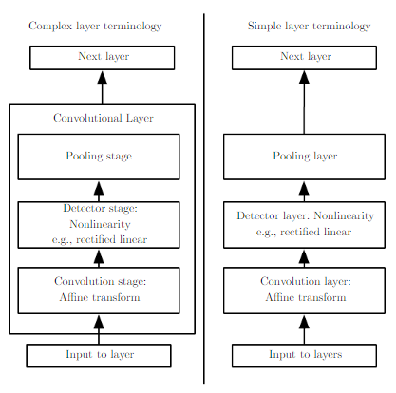
Modeling (1/3)

Slide 11
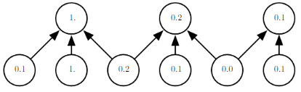
Modeling (2/3)
Pooling - replaces the output of the net at a certain location with a summary statistic of the nearby outputs
Invariant to small translations of the input
Abstracts features
Stride – distance between convolutions (downsampling)
Pooling 3, Stride 2

Slide 12
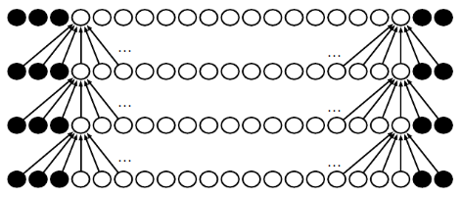
Modeling (3/3)
Padding
Useful for connections or images of difference sizes

Slide 13
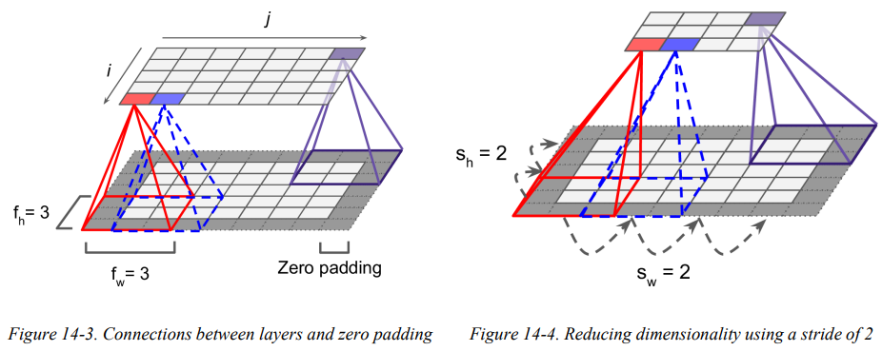
Convolutional Layer

Slide 14
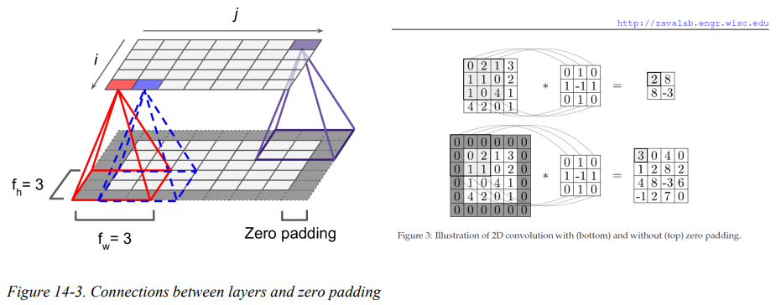
Convolutional Layer

Slide 15
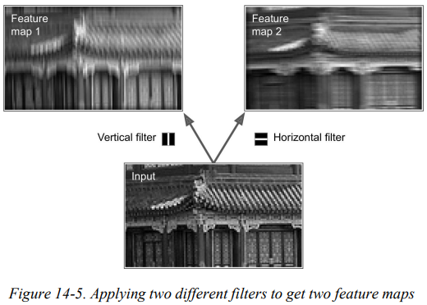
Filters
A neuron’s weights can be represented as a small image the size of the receptive field
Figure 14-5 shows two possible sets of weights, called filters (or convolution kernels)

Slide 16
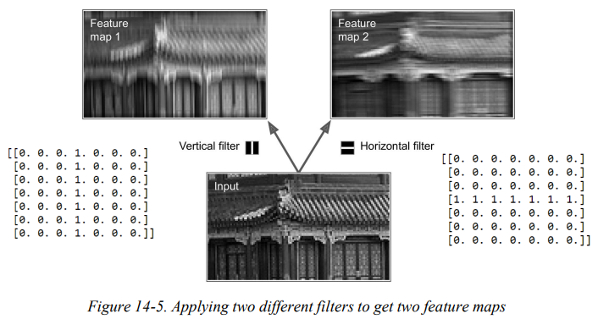
Filters

Slide 17
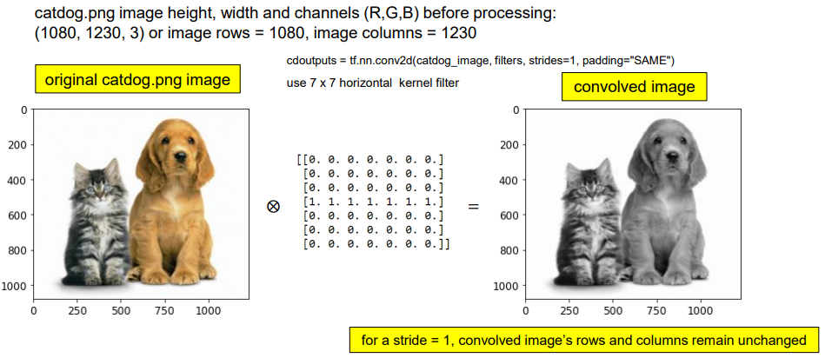
Filters

Slide 18
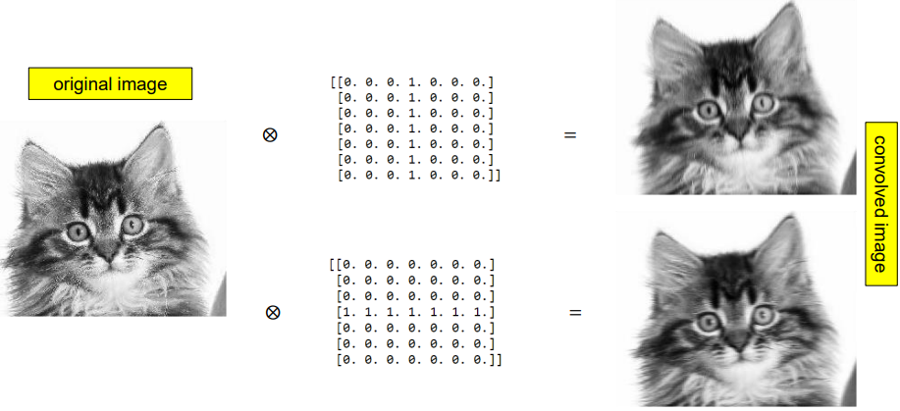
Filters

Slide 19
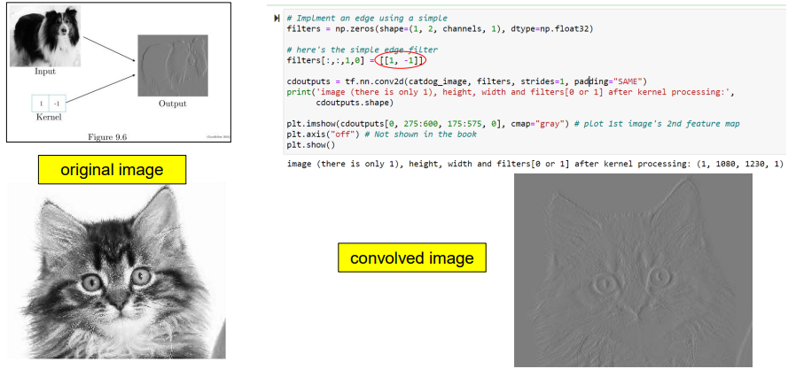
Filters

Slide 20
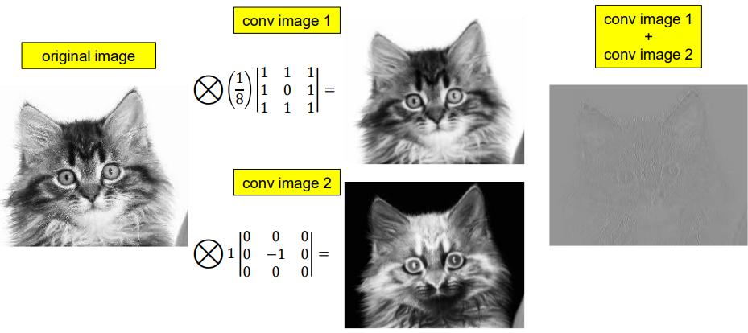
Filters

Slide 21
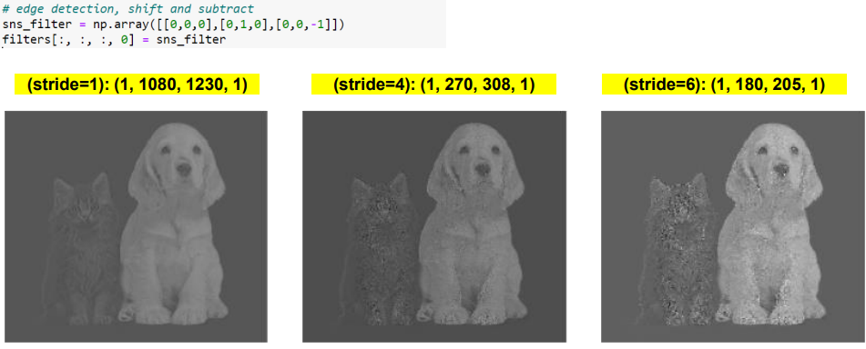
Filters: Varied Stride

Slide 22
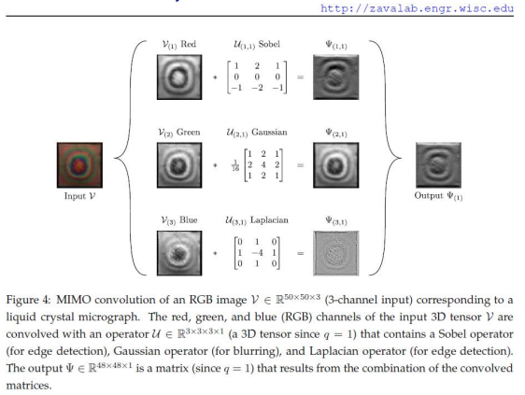
Filters: Other Examples

Slide 23
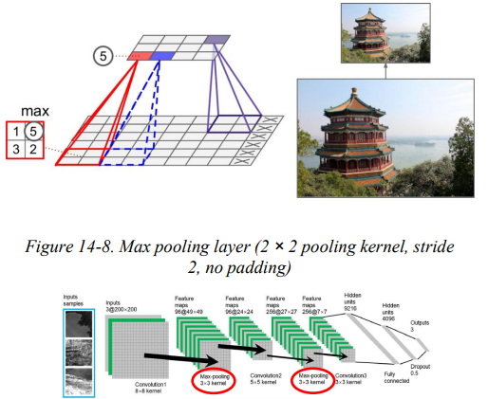
Filters
A pooling neuron has no weights
Pooling layer aggregates its inputs using a function (e.g., max, mean, etc)
Introduces some level of invariance to small translations
Downsamples an image by taking a small region of the convolutional ouput as input and produces a single output

Slide 24
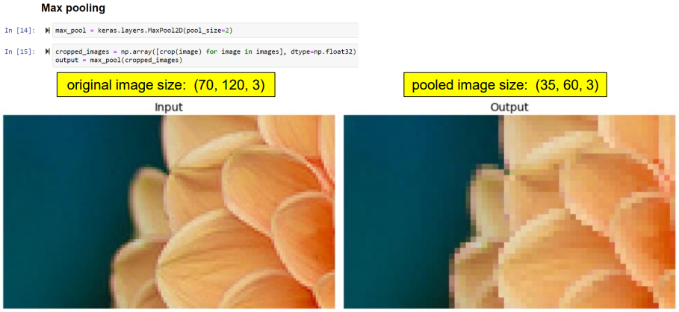
Pooling Example

Slide 25
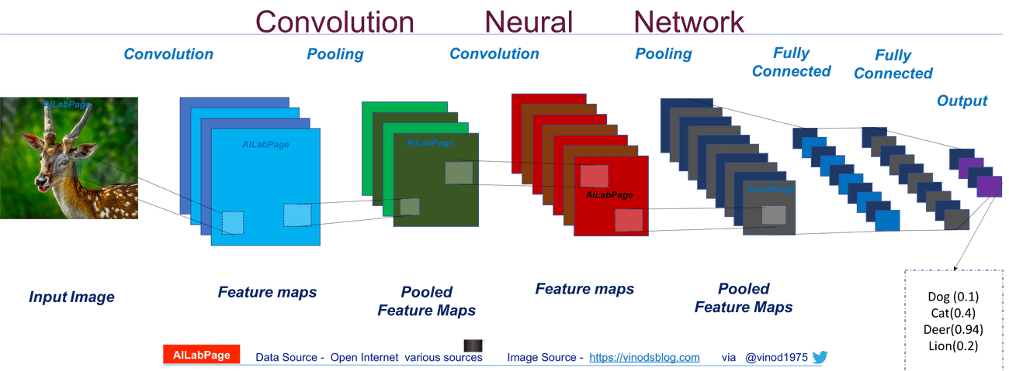
Typical CNN Architecture

Slide 26
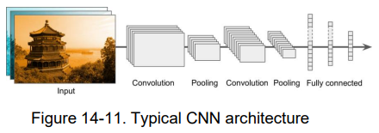
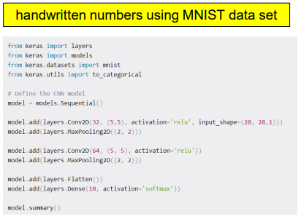
Coming Examples
Feature maps are the output of the convolution after an activation function is applied
We don’t know what the filters should look like for any given problem…the mind-blowing part is that CNN works out what each filter should look like automatically (how?...backpropagation)
Pooling reduces the spatial dimensions of the output volume

Slide 27
Why Convolution?
Problems with fully connected networks on images
Binary classification on a (small) greyscale image
256 x 256 = input size 65,536
Hidden layer nodes: 1000; output: sigmoid
Weight matrix size ~65M parameters in the first layer
How many images would be required to train?
Color 256 x 256 x 3 = 196M parameters
4K color image: 3840 x 2160 x 3 > 25B parameters
Making networks for large input
Fully connected networks are untrainable on even medium-sized inputs
Need to reduce the number of parameters to make training tractable
Key methods
Sparse interactions via convolution
Parameter sharing
Equivalent representations

Slide 28
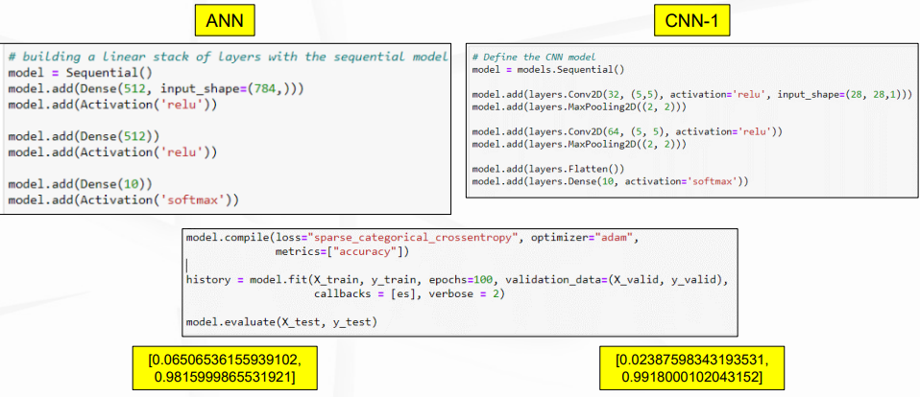
CNN Architecture: MNIST

Slide 29
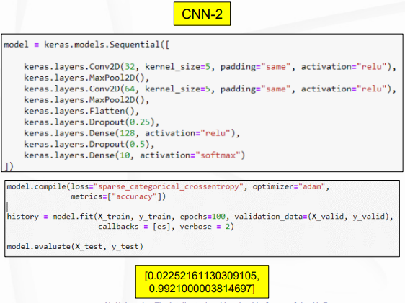
Another CNN

Slide 30
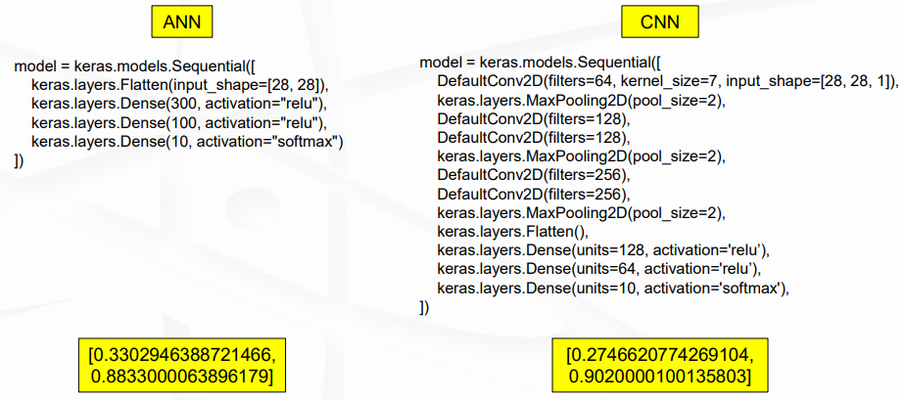
CNN Architecture: Fashion MNIST

Slide 31
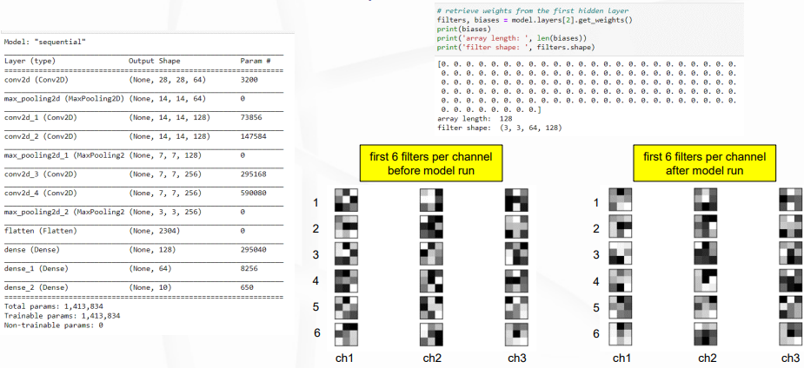
Convolutional Filtering

Slide 32
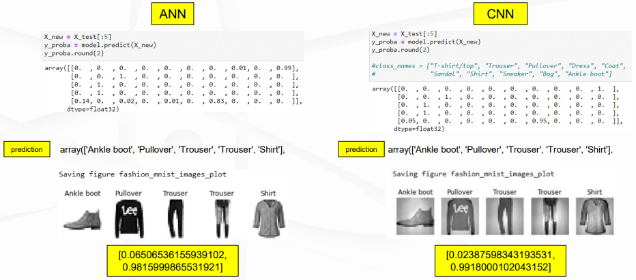
CNN Results

Slide 33
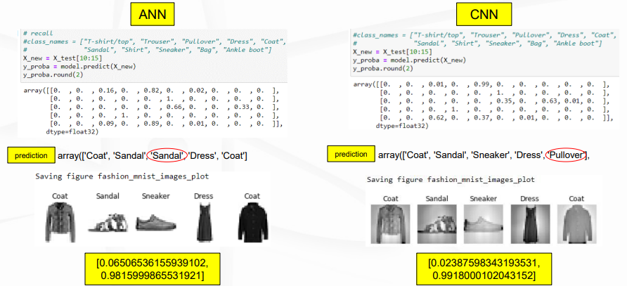
CNN Results

Slide 34
CNN Architectures
LeNet-5: most widely known CNN architecture (1998)
Large Scale Visual Recognition Challenge (ILSVRC) ImageNet challenge winners
AlexNet (2012): first CNN to stack convolution layers on top of each other
Uses dropout and data augmentation to reduce overfitting
GoogLeNet (2014): deeper than previous CNNs
Uses 1x1 kernels to capture patterns along the depth dimension
VGGNet (2014 runner up): simple/classical architecture
ResNet (2015): deep model with less parameters
Xception: merges ideas of GoogLeNet and ResNet
SENet (2017)
YOLO (You Only Look Once)

Slide 35
Using Pretrained Models: ResNet
Keras can load the ResNet-50 model
Pretrained on IMageNet
See jupyter notebook OPER 785 08 CNN2_ResNet_Ex.ipynb

Slide 36
Questions

